Slide 1



ORDER PROCESSING SYSTEM

Slide 2




Home Page
Home page contains links for employee login and customer login.
This is the first page of application.

Slide 3
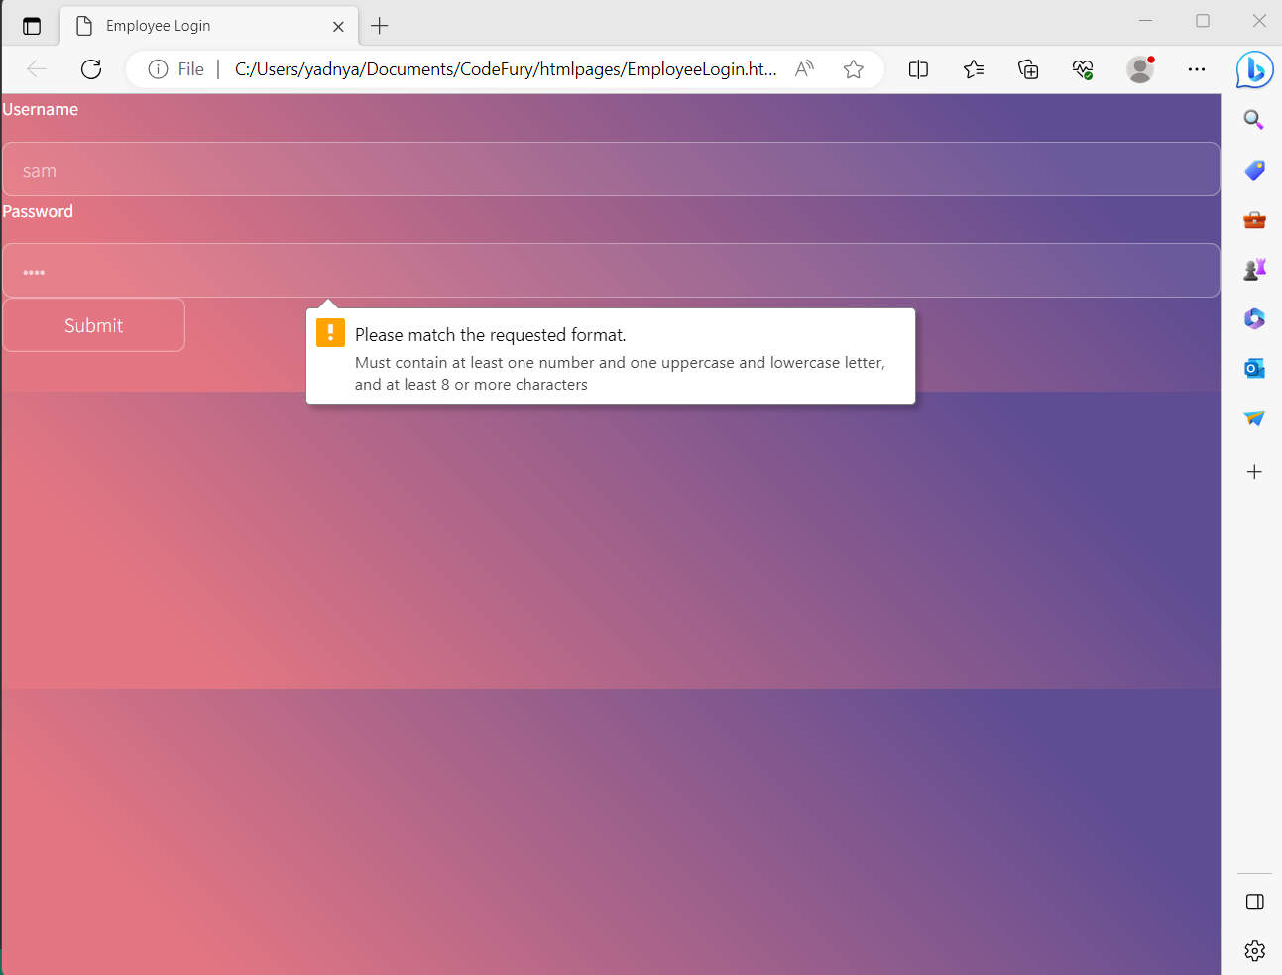
Employee login
Employee login takes customer username and password as input and treats both the fields as mandatory
It prompts an alert message if the appropriate criteria is not met for password.

Slide 4
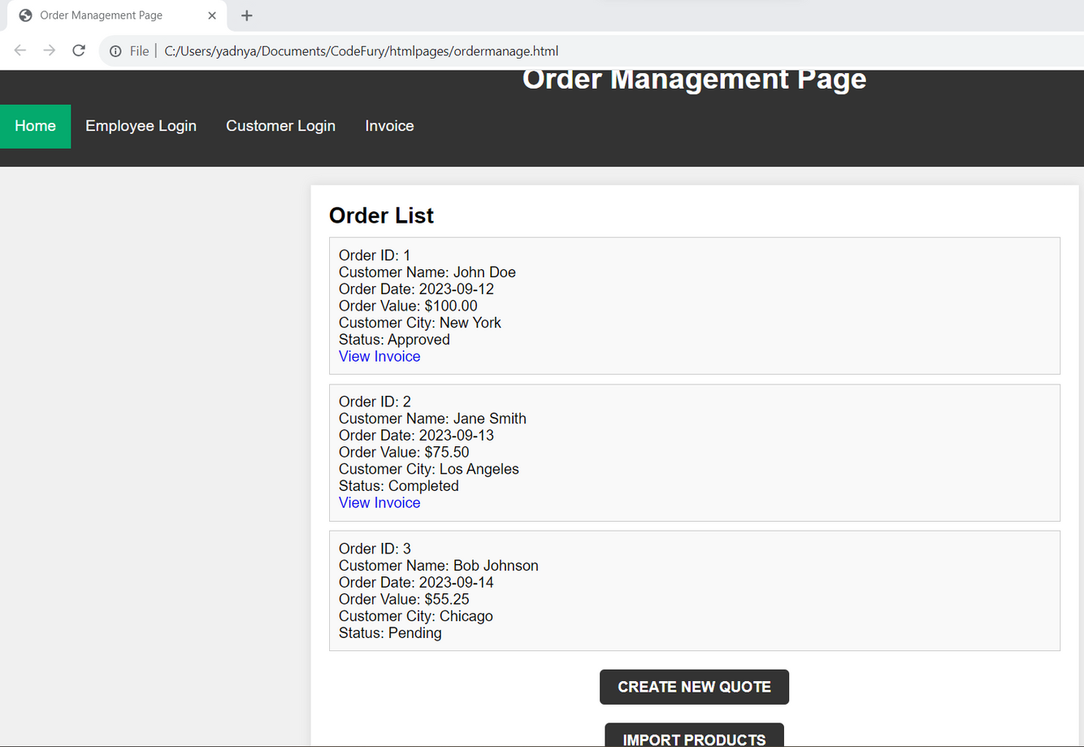
Order Management
Order management page displays order id, customer name,order date ,value,customer city,status.
It also contains create new quote button and import products button.

Slide 5
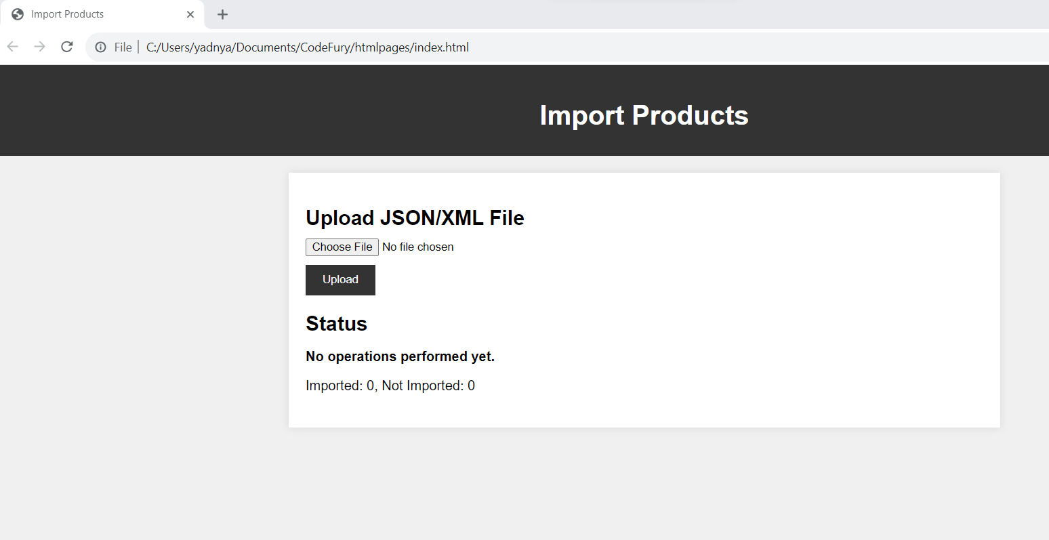
Import Products
Order management page displays order id, customer name,order date ,value,customer city,status.
It also contains create new quote button and import products button.

Slide 6
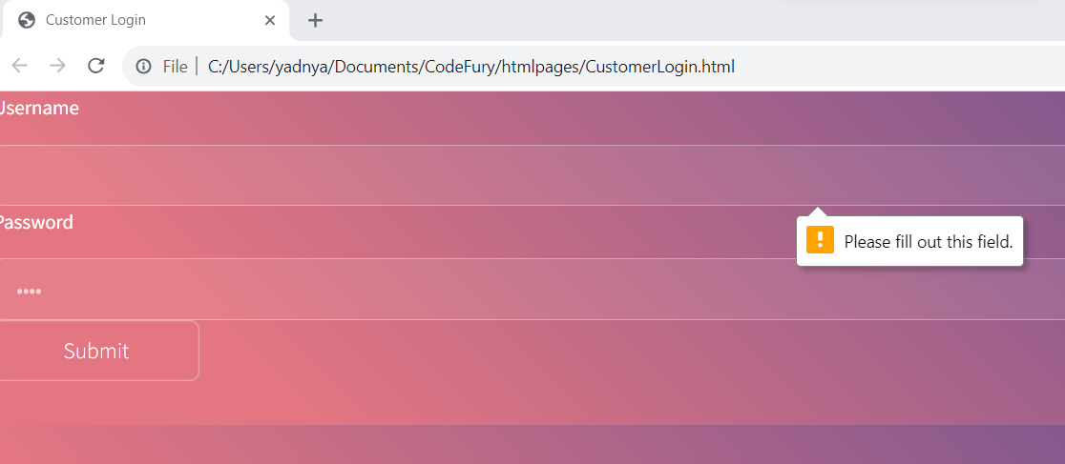
Customer Login
Customer login is similar to employee login .
It treats username and password field as mandatory and generates alert for invalid password.

Slide 7

Create Quote Page
This page allows a customer to generate a quote.
A quote is nothing but a order pending to be approved by the customer.
This allows the customer to finalize their orders easily.

Slide 8


Let’s explore features of creating a quote page

Slide 9
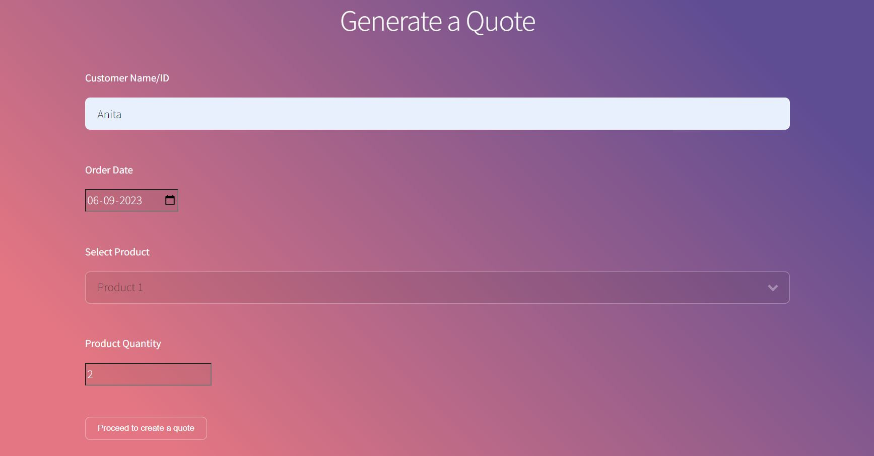

Customer name
Order Date
Selected Product
Product Quantity
Button to proceed

Slide 10
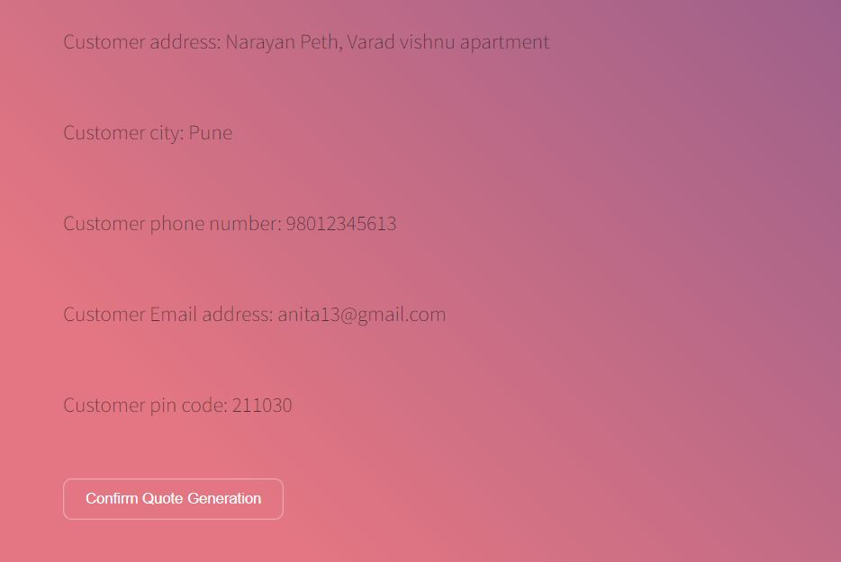
Once the proceed button is clicked customer details are auto-populated

Slide 11

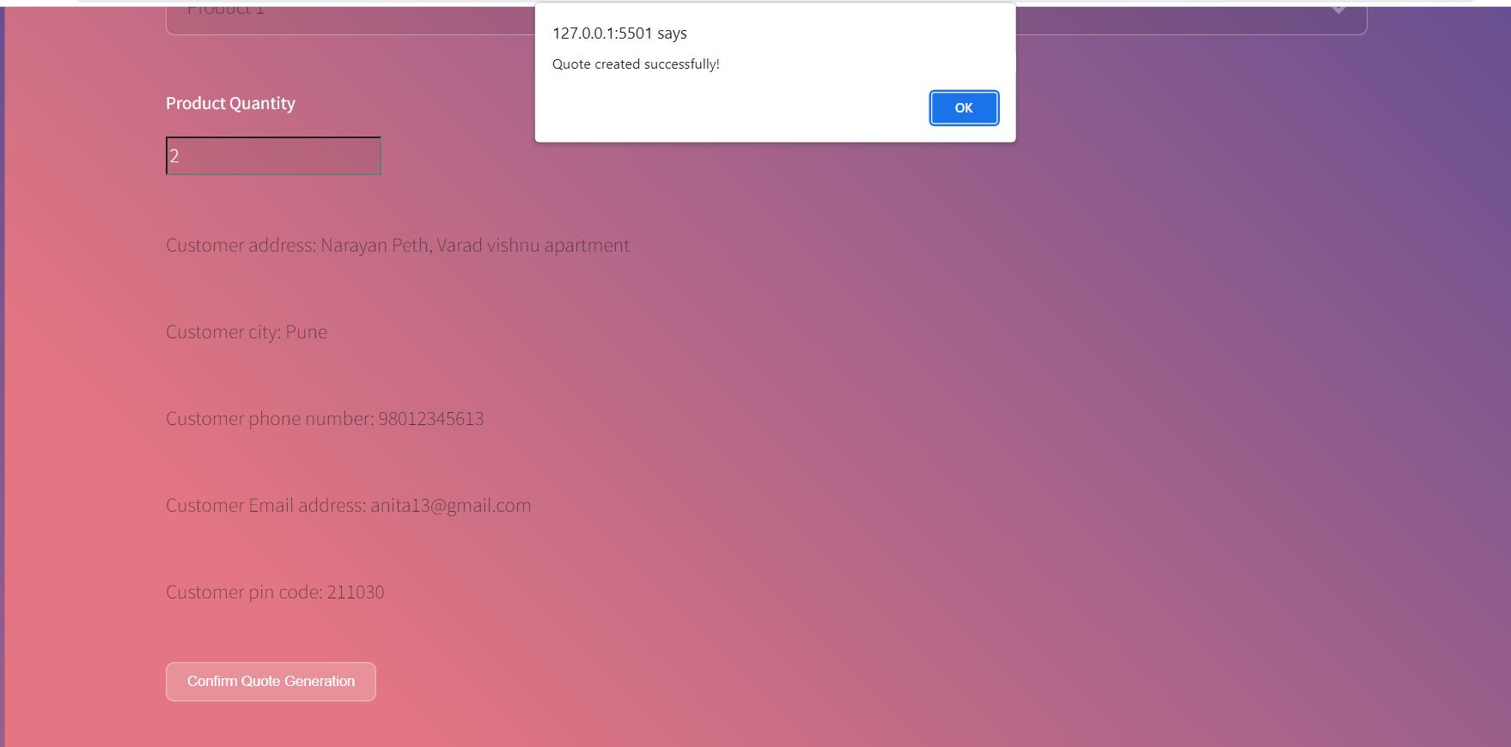
Quote created successfully notification upon successful validation

Slide 12
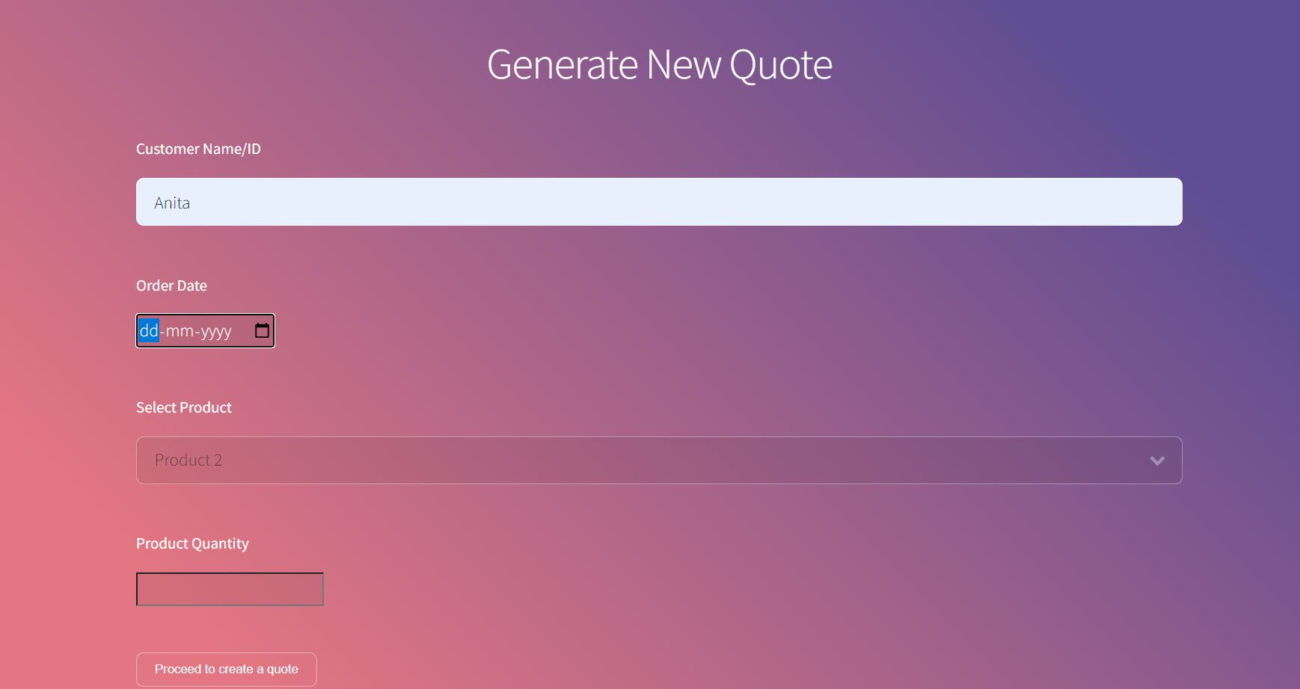
Screen clears up to allow customer to generate new quote

Slide 13
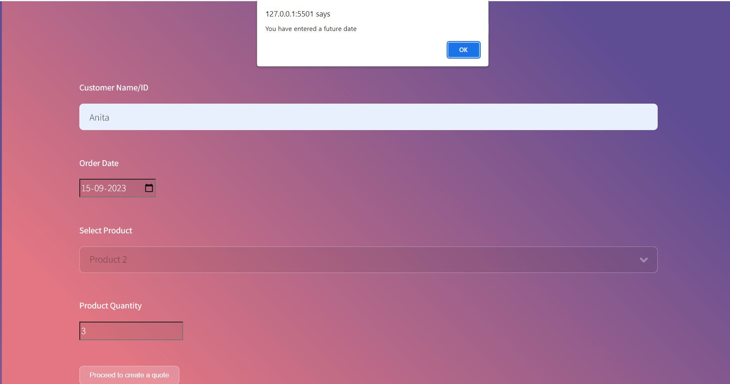

Quote is not generated if the customer enters a future date

Slide 14
Let’s explore features of order management page

Slide 15

Order Management Page
This page allows the employee to view the status of orders.
These are the quotes generated by customers.
If the quote status is pending then the employee can approve it for further processing.

Slide 16
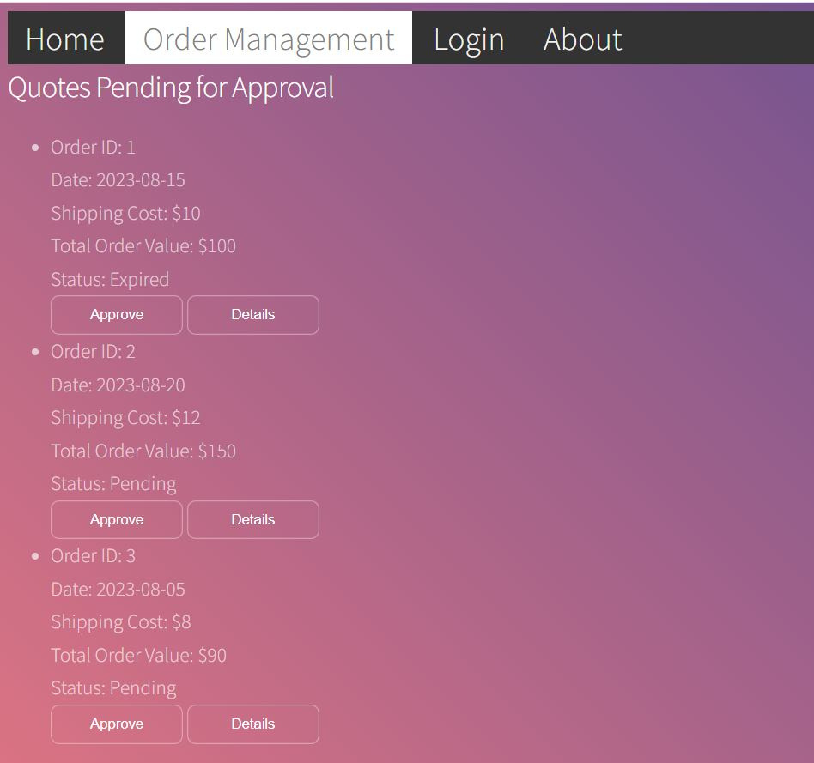
List of pending quotes along-with details visible to employee

Slide 17
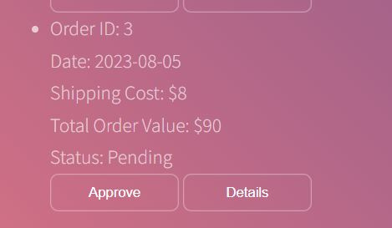
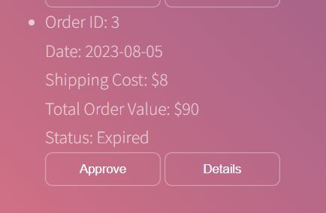
After employee approves the quote the status changes to expired if order date has already passed by

Slide 18
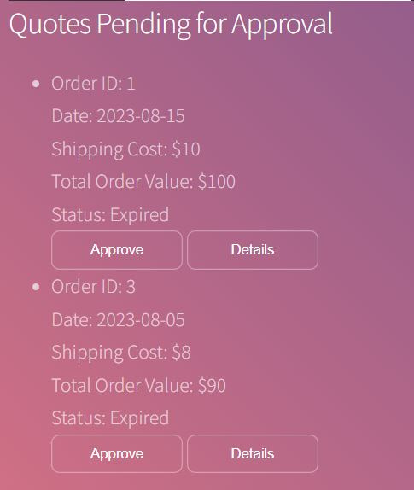
Quote disappears from pending list and appears in the approved list if the quote is approved before deadline.
(Order ID 2 disappears from pending list after approval)

Slide 19
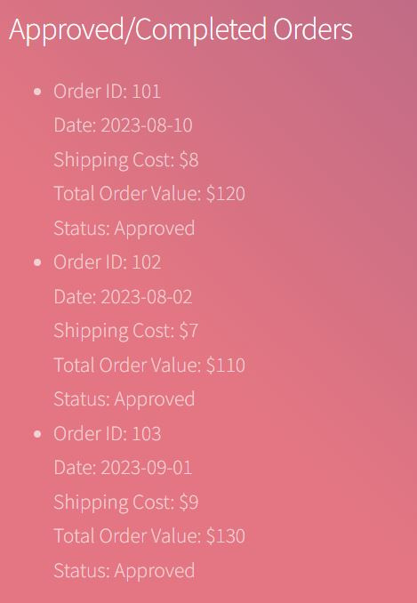
List of approved orders visible to employee

Slide 20

Order Management Page (Customers)
This page allows the customers to view the status of orders.
These are the status of quotes generated by customers.
If the quote status is complete customer can view the invoice.

Slide 21
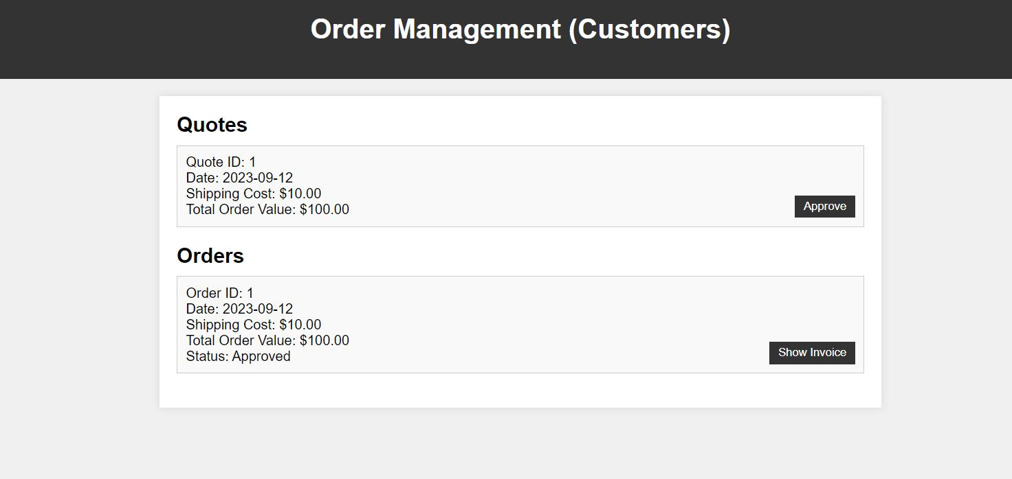
UI allows the customers to view the status of the quotes

Slide 22
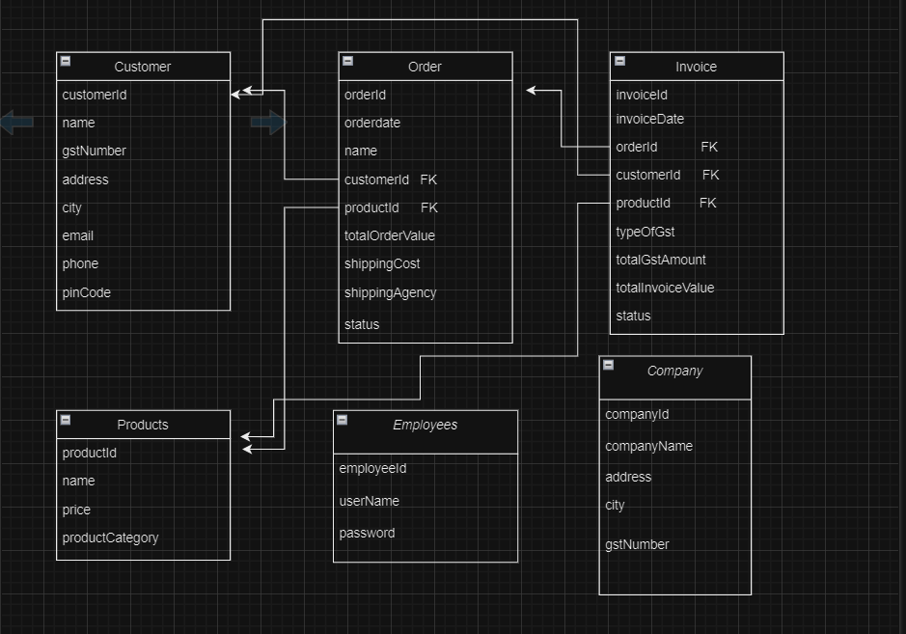
ER Diagram

Slide 23
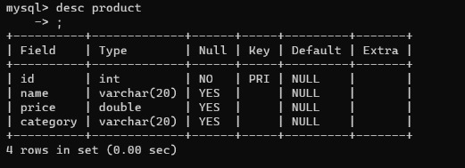
Products
Database to store the details of all the products.
ProductId acts as the primary key here.
The database is used for importing products service and order management service

Slide 24
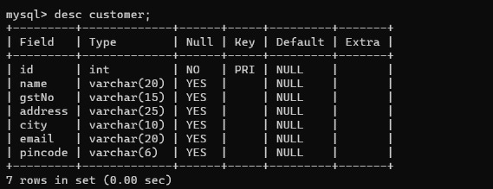
Customer
Database to store the details of all the customers.
Id acts as the primary key here.
The database is used for customer login service and order management service from the customer’s end.

Slide 25
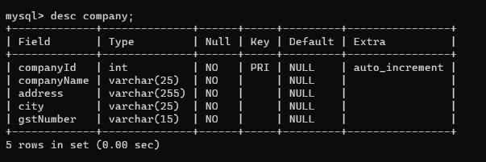
Company
Database to store the details of all the companies with companyId being the primary key.

Slide 26
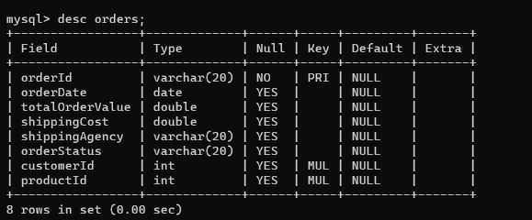
Orders
Database to store the details of all the orders placed by the customer.
ProductId acts as the primary key here and customerId and productId are foreign key referencing the cutsomer table and the product table.
The database is used for managing quotes and order management service

Slide 27
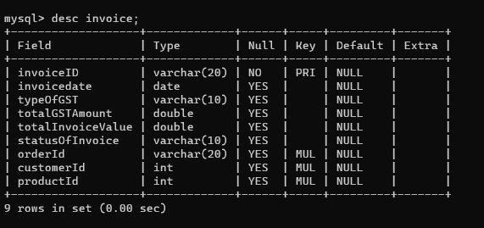
Invoice
Database to store the details of all the invoices . It stores important details like GST amount and invoice value.
InvoiceId acts as the primary key here, with orderId, customerId and productId being the foreign key.

